Slide 1
企業韌性和永續的博弈
－Development of Regulatory Strategies in the Sharing Economy:
The Application of Game Theory

Slide 2
Introduction
The sharing economy has a high potential to change existing industries by identifying new market niches and alternative ways to meet economic agents' needs, while also posing a threat to traditional economic models.
Collaborative consumption and the use of digital platforms significantly reduce transaction costs and reshape relationships between economic agents.

Slide 3
Introduction
The rapid penetration of platform relationships, on which the sharing economy is based, requires new approaches to regulation.
Developing strategies for regulating the sharing economy based on game theory allows for optimal approaches to regulation to be determined and the interests of all participants to be reconciled.

Slide 4
Introduction
The study involved the following
Analysis of publications on the regulation of the sharing economy from the Scopus database.
Construction of a four-field matrix of strategies for the behavior of economic agents through the application of game theory.
Calculation of total benefits from interaction.
Identification of parameters to be considered when determining the strategy of behavior.
The designation of areas to be covered for the sustainable development of cooperative consumption strategies for boosting the sharing economy.

Slide 5
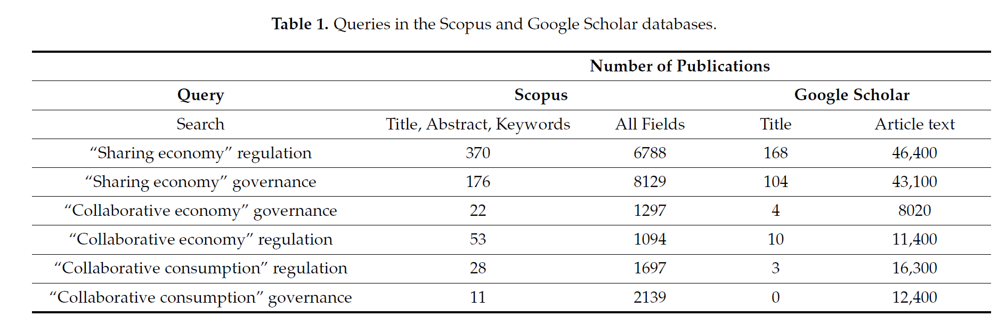
Approaches to Regulation of the Sharing Economy: Cooperation or Non-Cooperation

Slide 6
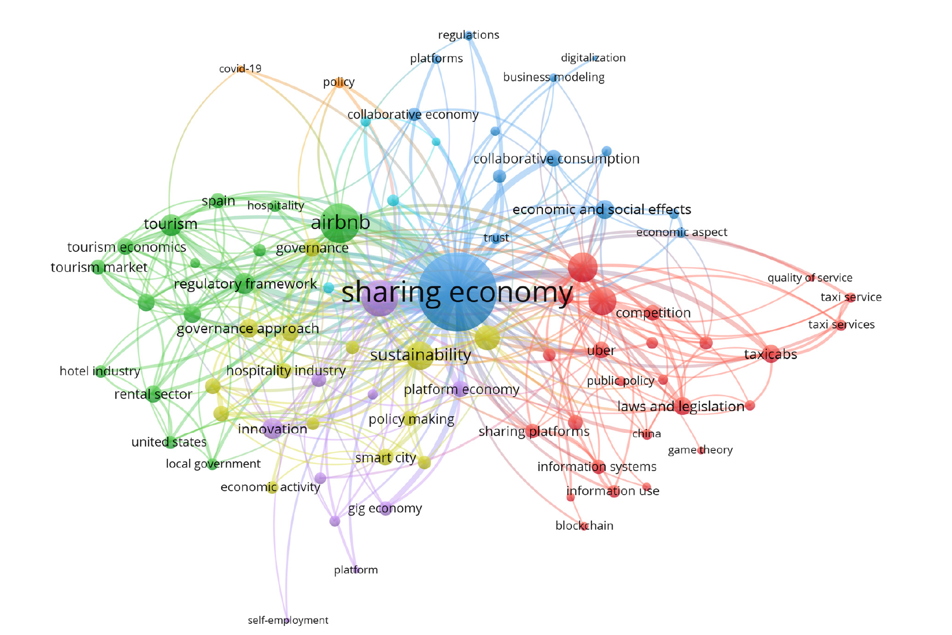

Slide 7
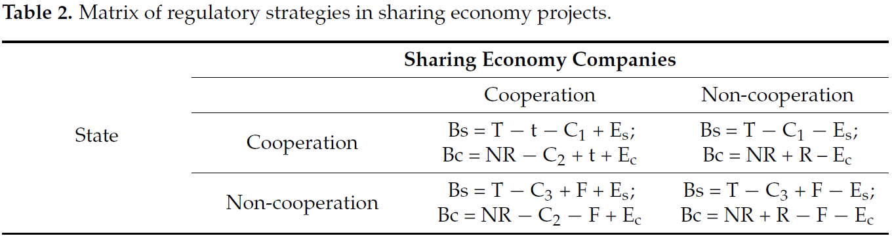
Matrix of Strategies

Slide 8
Matrix of Strategies
T—net tax paid by sharing economy companies.
NR—net revenue of sharing economy companies.
R—additional rent.
C₁—program development costs.
C₂—new technologies introduction costs for cooperation development.
C₃—control costs.
t—transfer payments.
F—fines.
E_{s}—intangible effects for the state.
E_{c}—intangible effects for the company.
B_{s}—general benefits for the state.
B_{c}—general benefits for the company
These strategies are considered in relation to three problems:
environmental pollution, parking deficiency, and budget deficit.

Slide 9
－Environmental Pollution
Strategies of the State:
Cooperative Strategy: developing programs for sharing economy companies that encourage the use of electric vehicles or environmentally friendly technologies.
Non-Cooperative Strategy: imposing strict regulations and emission fines to reduce air pollution.
Strategies of Sharing Economy Companies:
Cooperative Strategy: adopting clean technologies and providing electric vehicles to reduce emissions and improve the total utility for all participants.
Non-Cooperative Strategy: maximizing their individual utility by offering vehicles with lower rental costs and amenities unrelated to eco-efficiency.

Slide 10
－Environmental Pollution
E_{s} means the contribution to the environmental state and sustainability of the territory.
E_{c} includes customer loyalty and corporate policy.
C₁ the development of programs to encourage the use of clean technologies and electric vehicles, as well as the allocation of transfers.
C₂ the introduction of clean technologies and the provision of electric vehicles by the companies.
C₃ mandatory control over the sharing economy companies

Slide 11
－Parking Deficiency
Strategies of the State:
Cooperative Strategy: development of programs for sharing economy companies to encourage the use of designated parking spaces or the sharing of existing parking spaces with other companies.
Non-Cooperative Strategy: introduction of high fines for the improper parking of sharing cars.
Strategies of Sharing Economy Companies:
Cooperative Strategy: collaboration with the state in the development of joint solutions to managing parking spaces and ensuring efficient use of resources.
Non-Cooperative Strategy: an ultimate increase in the number of cars in the city to meet demand and enhance individual utility, disregarding the potential parking deficiency and inconveniences for other participants.

Slide 12
－Parking Deficiency
E_{s} consists of resolving the city problem, reducing parking deficiencies, and offering citizens satisfaction.
E_{c} includes an increase in the availability of parking spaces for customers and customer satisfaction.

Slide 13
－Budget Deficit
Strategies of the State:
Cooperative Strategy: development of tax mechanisms to encourage sharing economy companies to invest in social programs.
Non-Cooperative Strategy: raising tax rates for sharing economy companies to increase revenue may lead to a higher financial burden and limited growth and development in the companies.
Strategies of Sharing Economy Companies:
Cooperative Strategy: voluntary participation in social programs aimed at solving public issues, regardless of tax payments.
Non-Cooperative Strategy: minimizing tax payments and using tax incentives to boost individual utility and profit.

Slide 14
－Budget Deficit
E_{s} includes the budget remedy and social development.
E_{c} consists in the reallocation of funds from tax expenditure to public needs and customer loyalty.
C₁ the development of tax mechanisms to encourage sharing economy companies.
C₂ Voluntary participation in social programs aimed at resolving public issues and maximizing total utility.
C₃ upholding and complying with tax legislation.

Slide 15
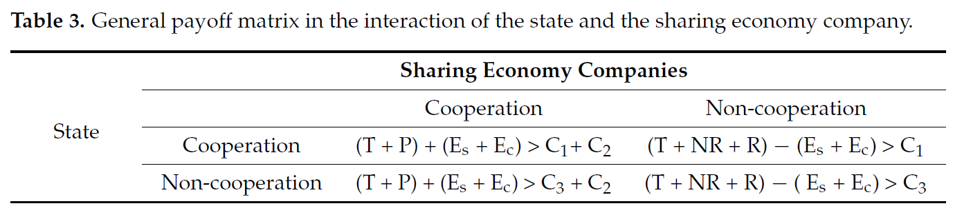
General Payoff Matrix

Slide 16
General Payoff Matrix
The “Cooperation–Cooperation” strategy is certainly considered to be the optimal and most mutually beneficial option. This scenario takes into account the interests of both the company and the state.
The “Cooperation(s)–Non-cooperation (c)” strategy appears sustainable in the short term. Its implementation suggests inadequate conditions for collaboration or a lack of trust in the state.
The “Non-cooperation (s)–Cooperation(s)” strategy focuses mostly on short-term cooperation.
The “Non-cooperation–Non-cooperation” strategy could endure until the negative effects become too high. Prior to this, the strategy can be sustainable.

Slide 17
Conclusions
The study identified common cooperative and non-cooperative strategies in the interaction of two participants: the state and the company.
The study demonstrated the application of this approach to resolving social problems.
The study calculated the general payoff matrix and indicated sustainable and longterm scenarios. In addition, the authors identified parameters to consider when choosing economic agents’ behavior strategies.
Employing cooperative strategies in the regulation of sharing economy initiatives creates new possibilities for addressing social and environmental issues, engaging both civil society and enterprises in this process

